Slide 1
PM Activities
UG Network

Slide 2
Primary Findings
Overloaded core capacity
Core identification problem
Extensive numbers of damaged cores
Splicing sleeves out of tray
Inappropriate core latching
GCO frame found on critical situation
Multiple operation on single tube
GCO body condition is not suitable

Slide 3
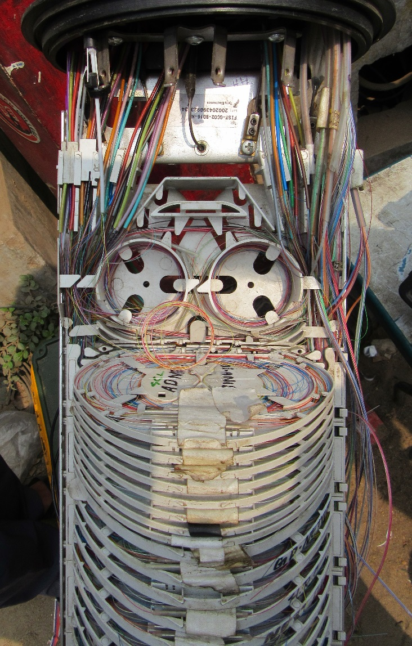
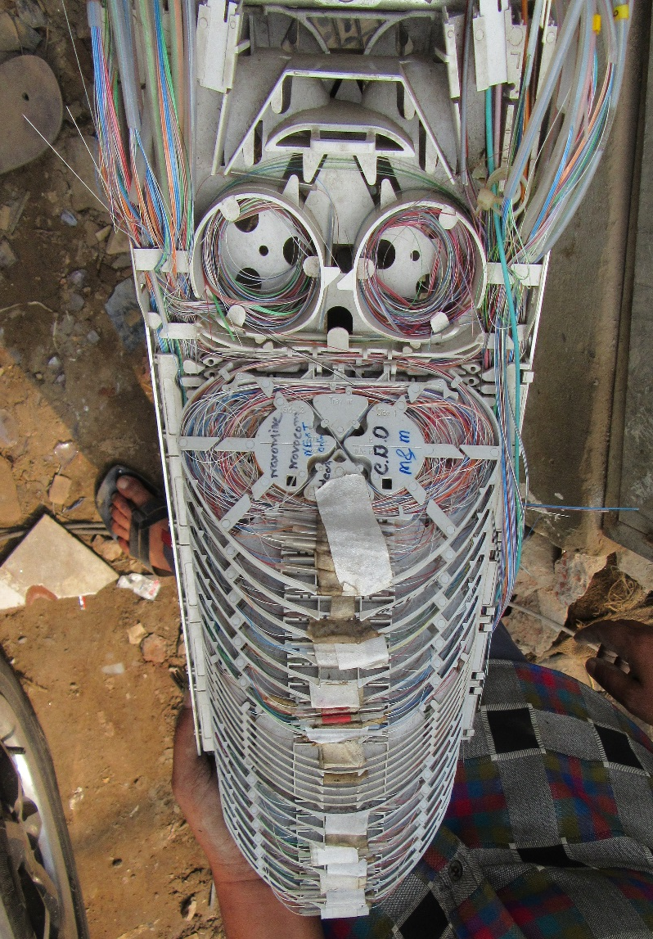
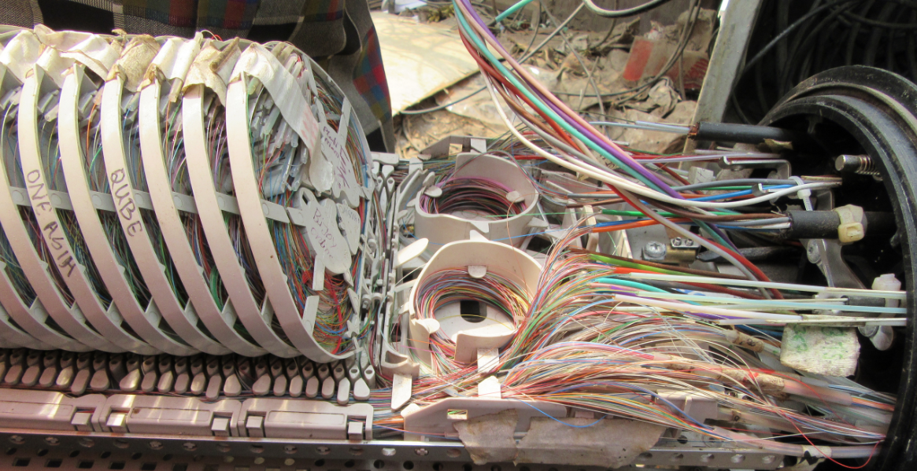
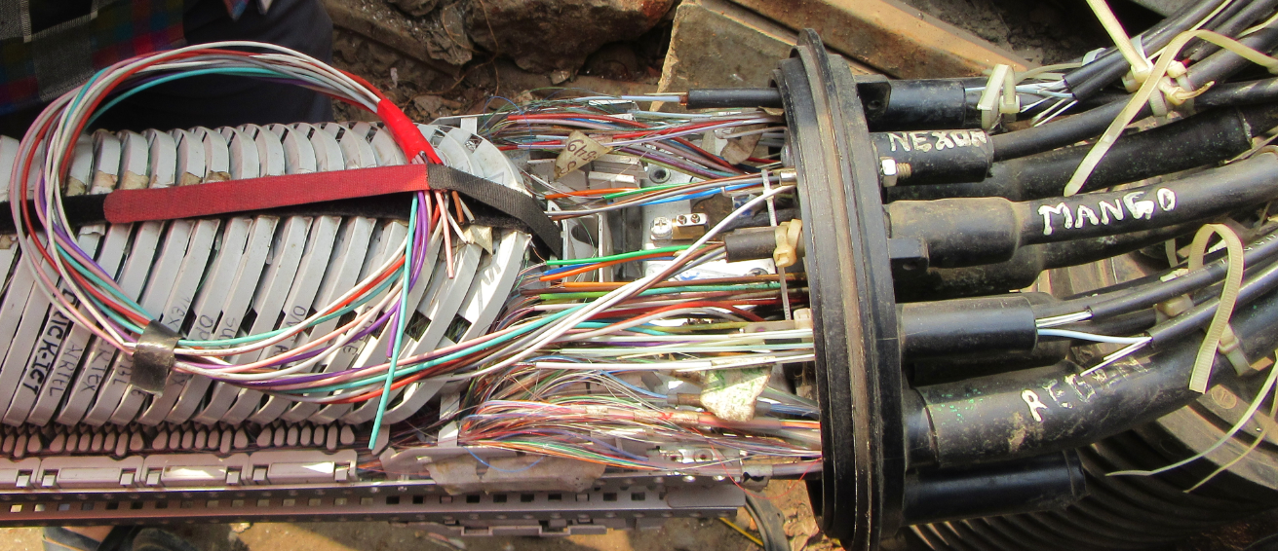
Snaps of vulnerable POCs
Jalkhabar Old POC New GCO
BanglaCat
Mango

Slide 4
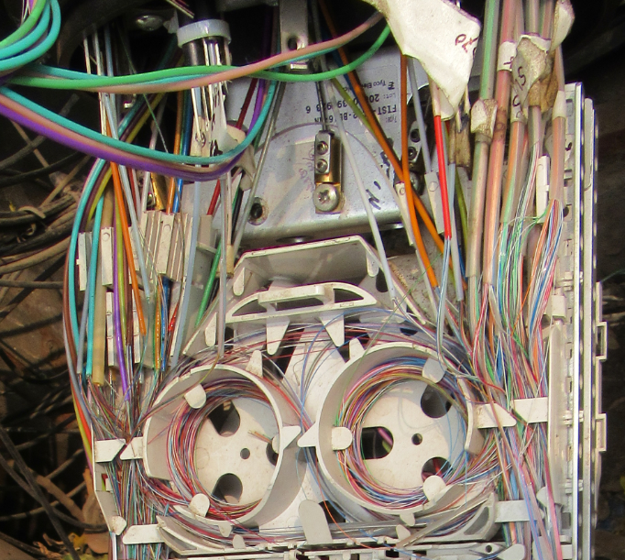
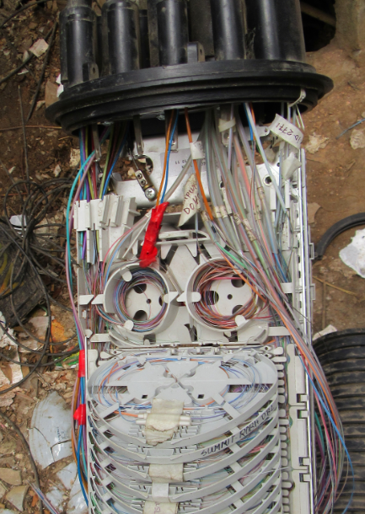
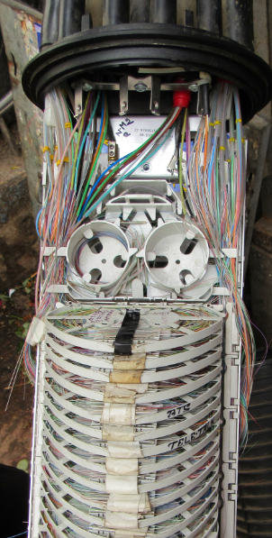
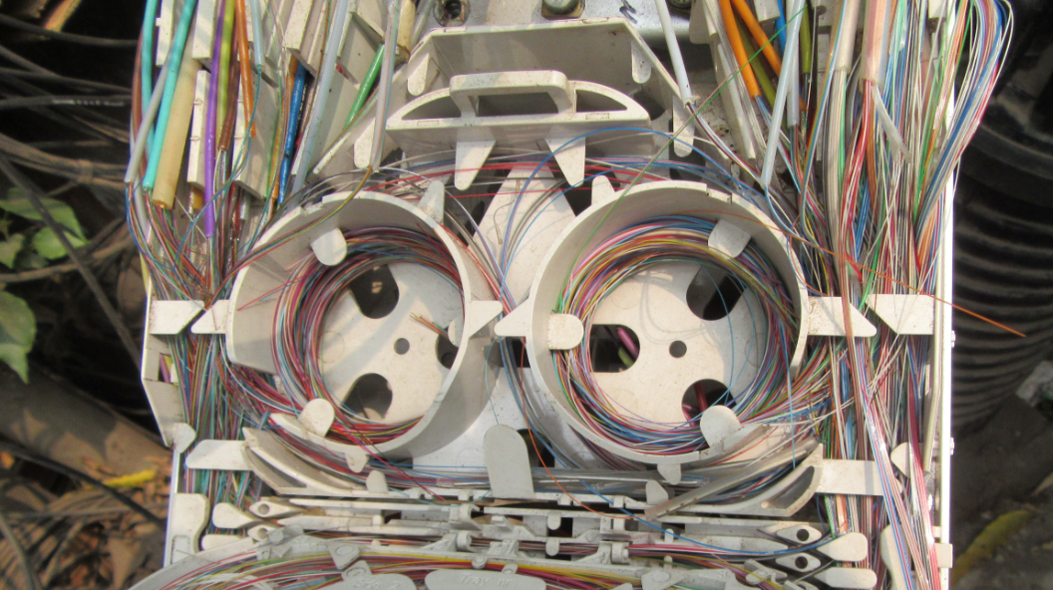
Snaps of vulnerable POCs(Cont..)
Gulshan-1 DCC Market
Gulshan BTCL New
Birdem Old POC New GCO

Slide 5
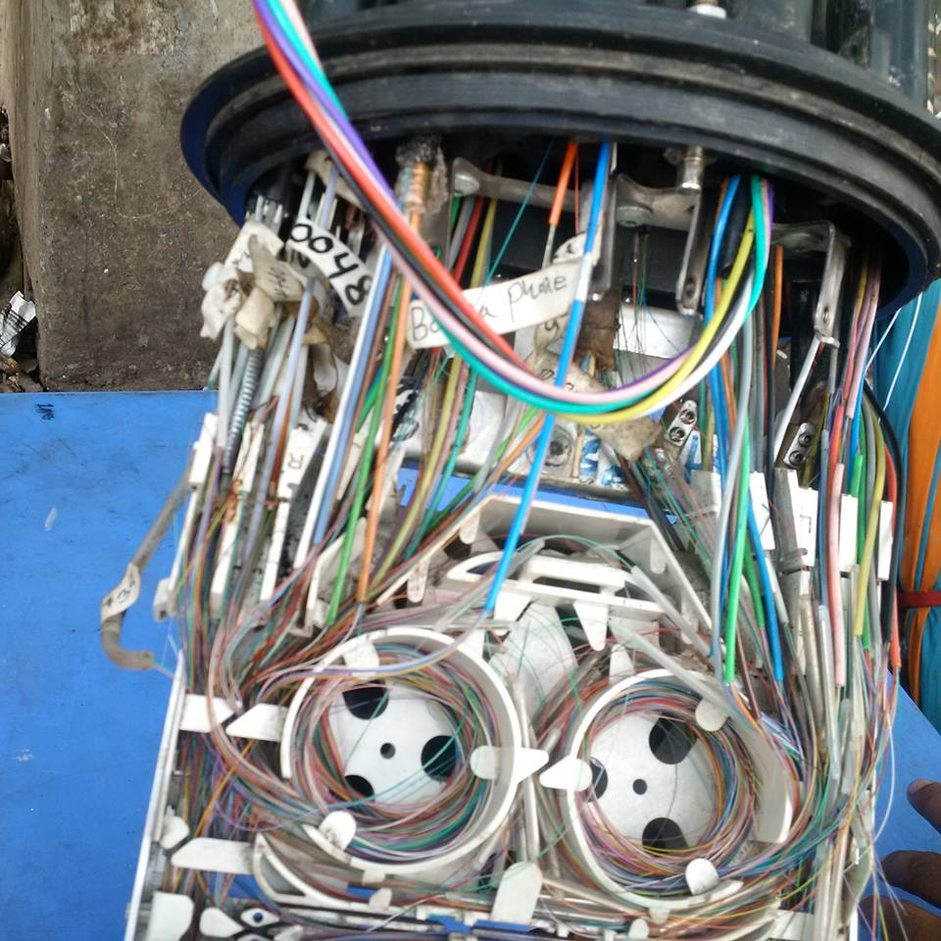
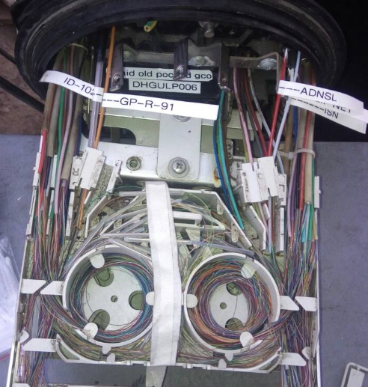
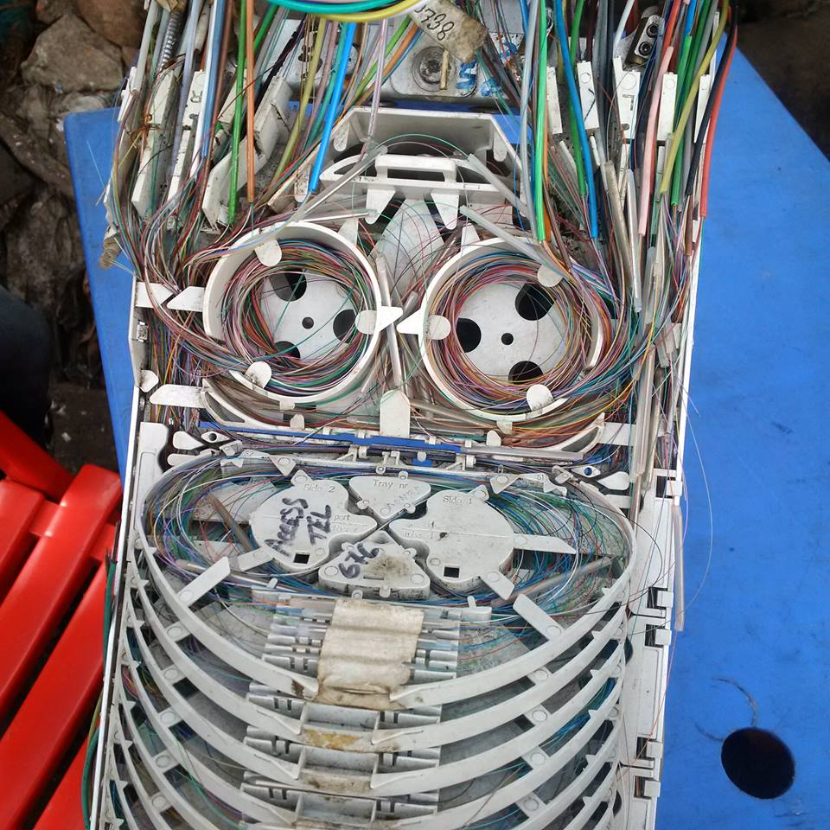
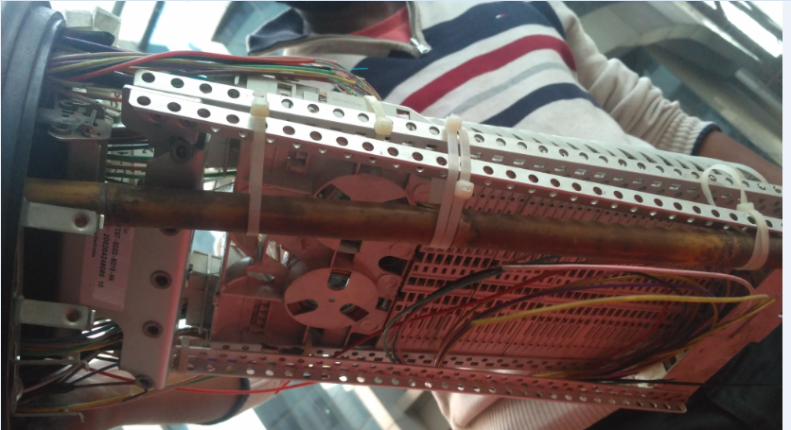
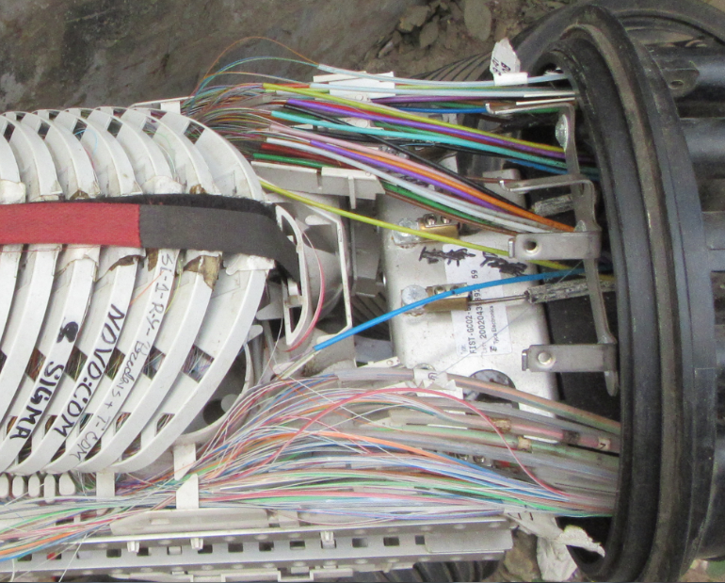
Snaps of vulnerable POCs(Cont..)
Pubali Bank Old POC Old GCO
Uday Tower
Labaid Old POC

Slide 6
Damaged Core Status
On average 10.00% damage core of listed 40 POCs...

Slide 7


